Slide 1


Team Project
-creating an application that can automatically dispatch tasks in a team-

Slide 2
Team Members
Ciucur Daniel
Opra Andrei
Tuns Adrian
Iovescu Andrei
Coordinator from Nokia company:
Gabriel Pistolescu

Slide 3

Idea
Creating a web app which has two kind of users:
Manager and Programator
Automatic dispatch of tasks based on employee workload

Slide 4






Tools, programming languages used...
ASP

Slide 5
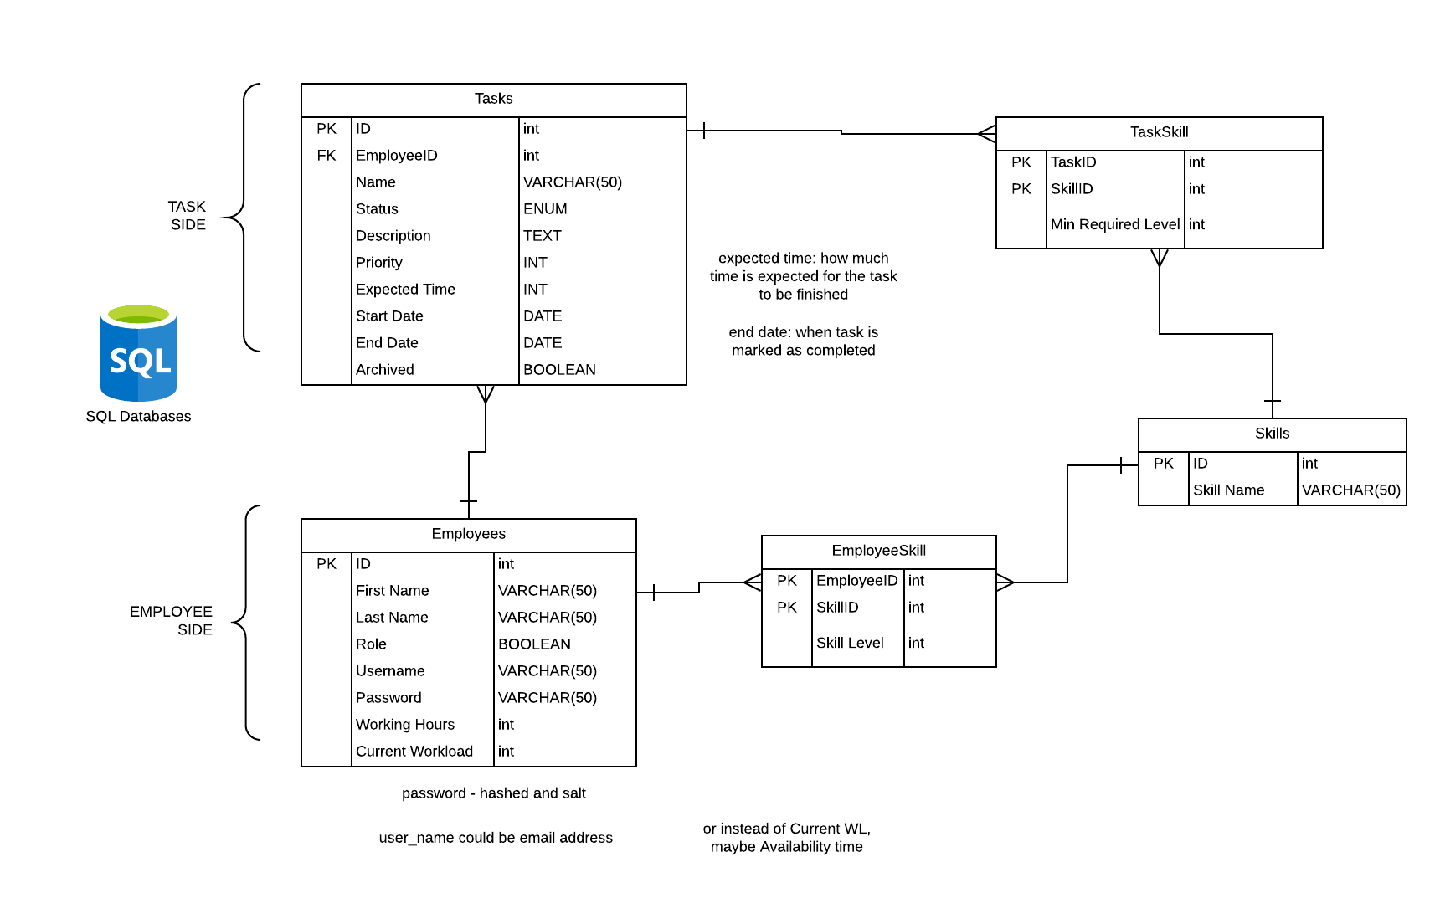

Slide 6
How is the website structured

Slide 7
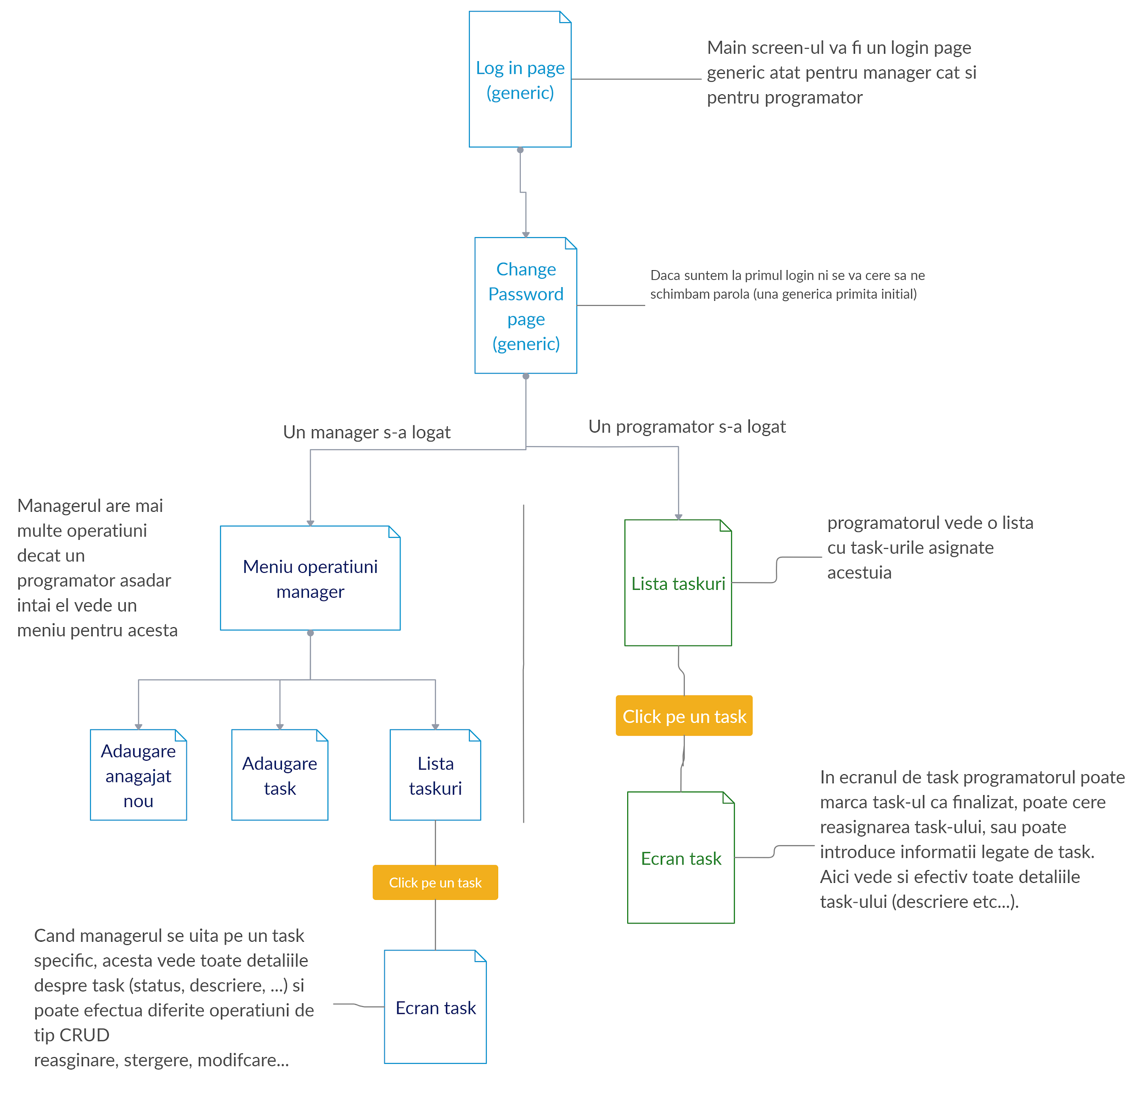

Slide 8
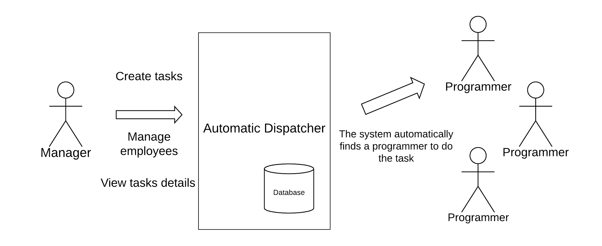

Slide 9
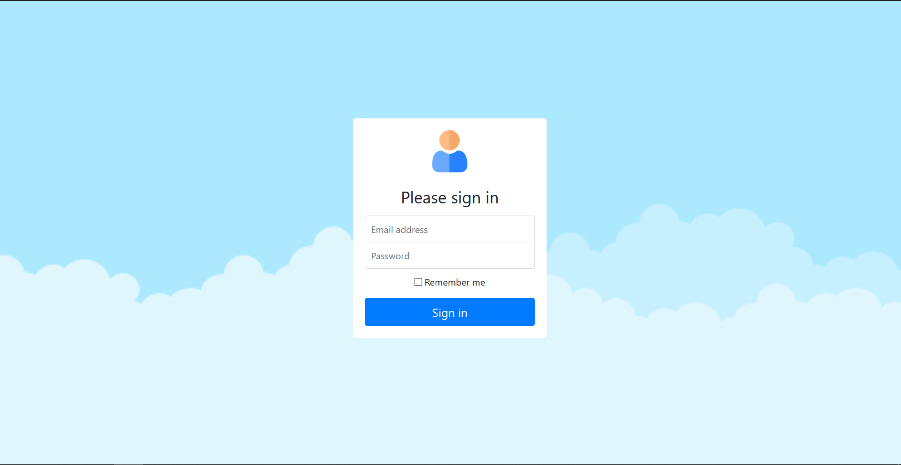
Login Page
All the employees that have access to the Automated Dispatcher web app have a dedicated user and password located in the application database. When a user starts the application, it is prompted with a screen where it has to fill in its login credentials.

Slide 10
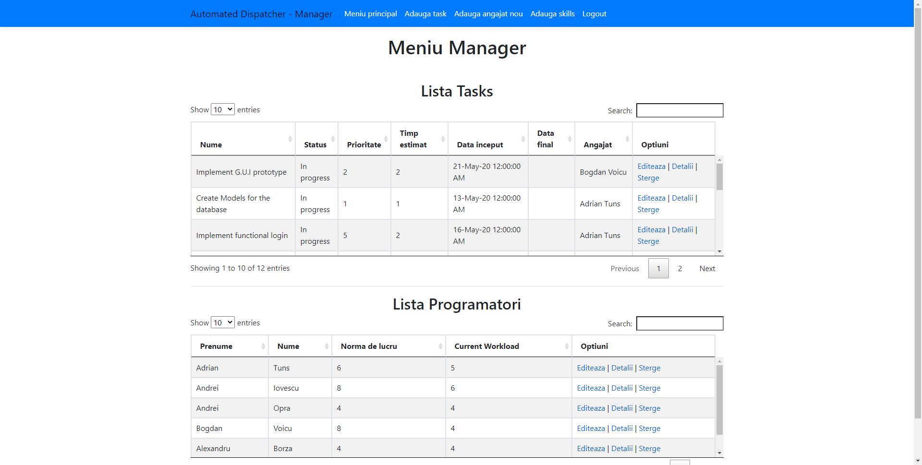
Manager Screen
The manager has the responsibility to coordinate the team, and thus it should have access to all the useful information such as: Task List, Team Members and the details of each entry. The manager can also edit and/or delete tasks or employees.

Slide 11
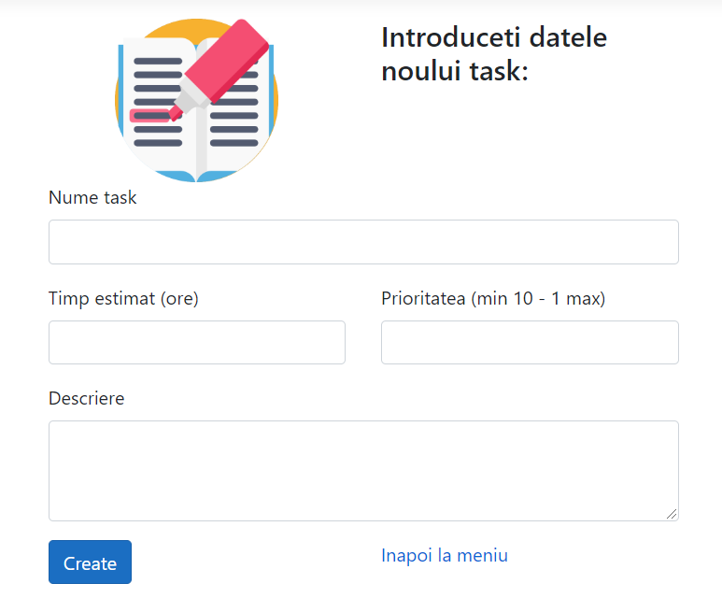
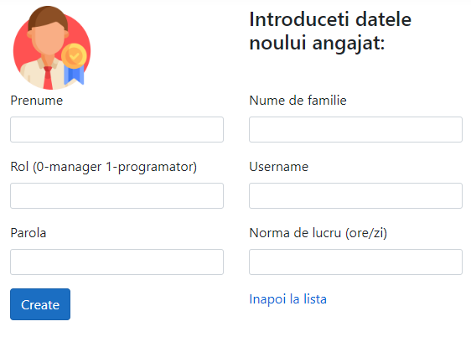
Manager Functions

Slide 12
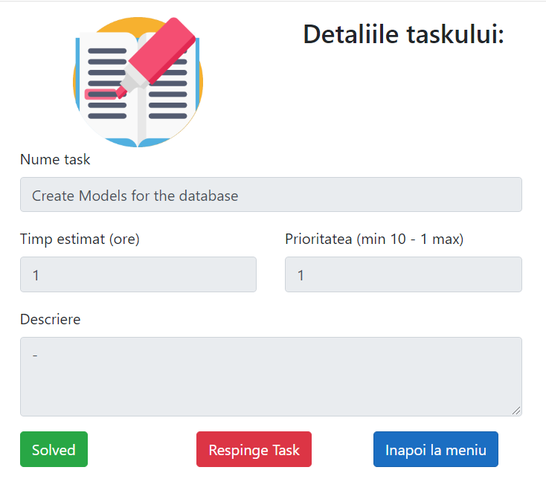
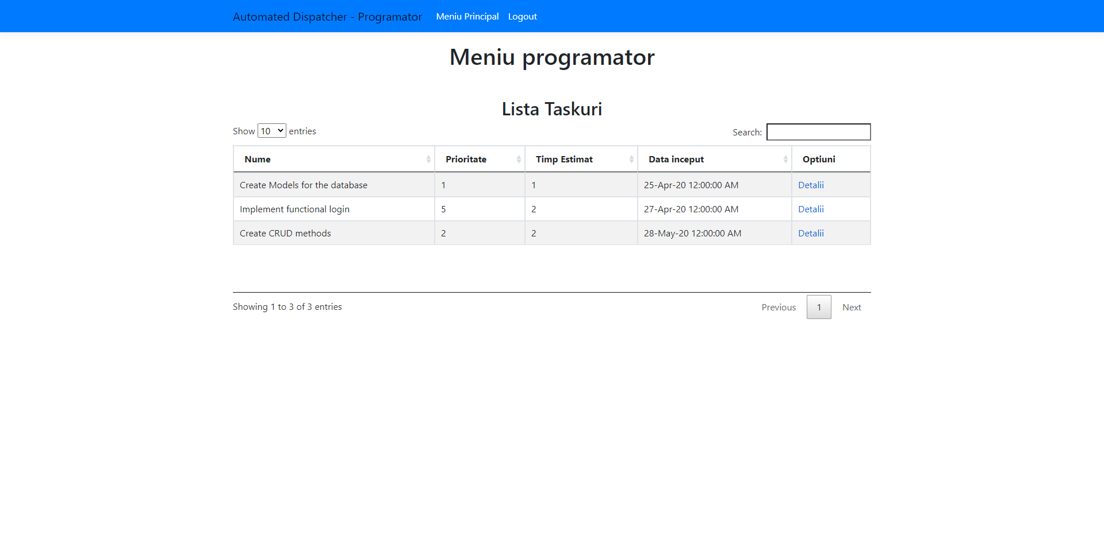
Programmer Screen

Slide 13
Questions?

Slide 14
Thank you!

